Slide 1
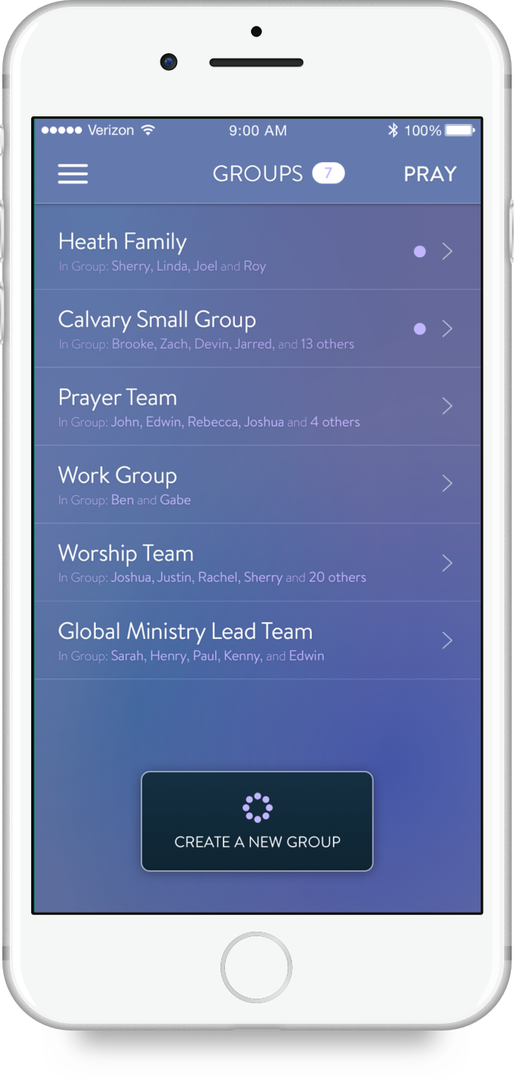
USING
ECHO GROUPS

Slide 2
PRAY WITH:
SMALL GROUPS
MINISTRY TEAMS
Echo Groups was created for any group of people to be actively connected through prayer.
FRIENDS
FAMILY MEMBERS
COWORKERS

Slide 3
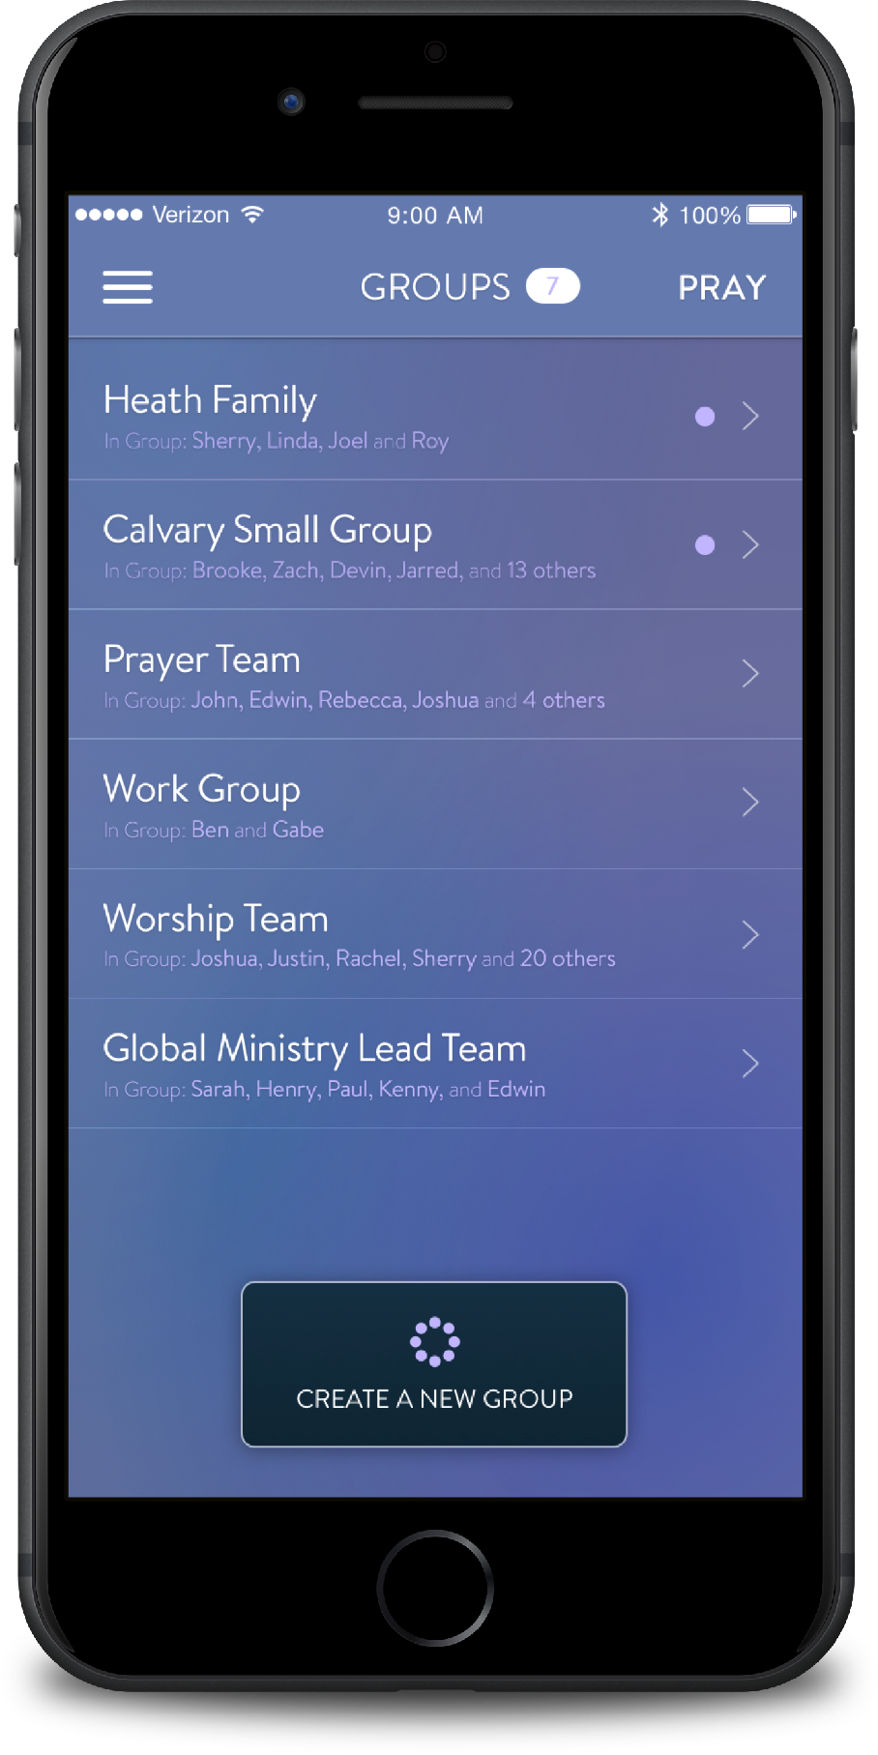
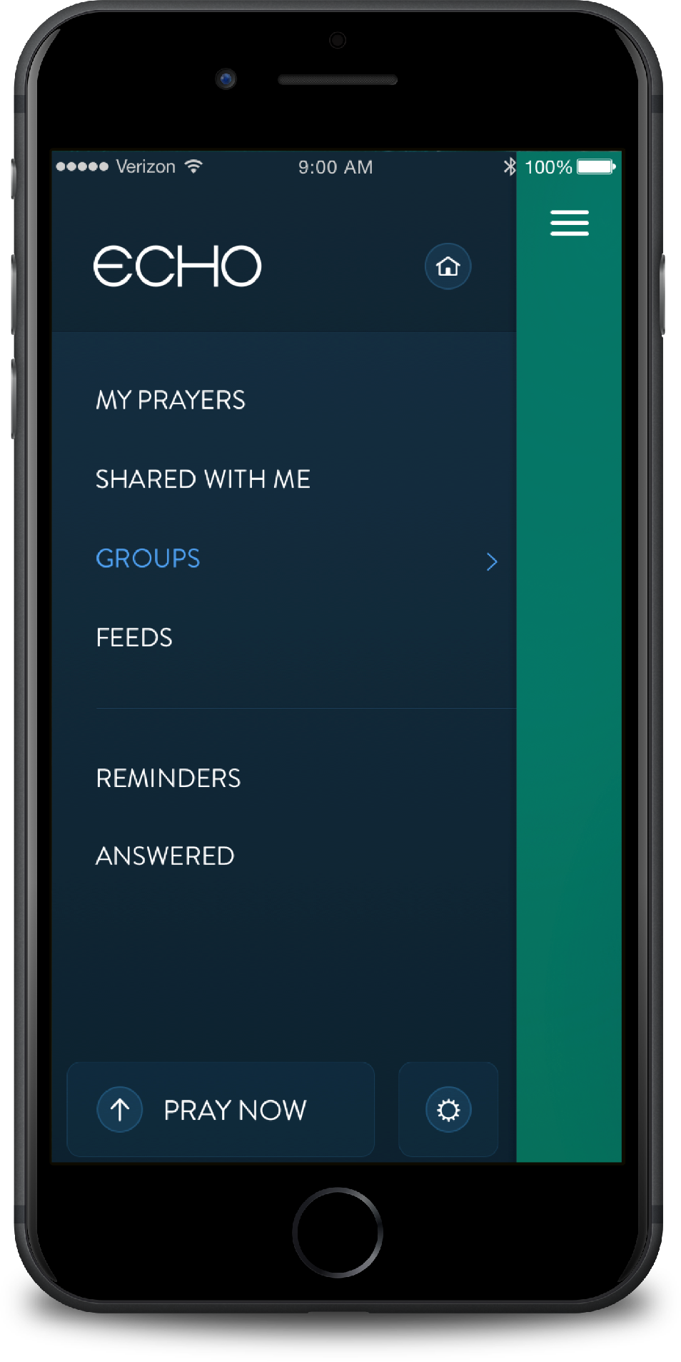
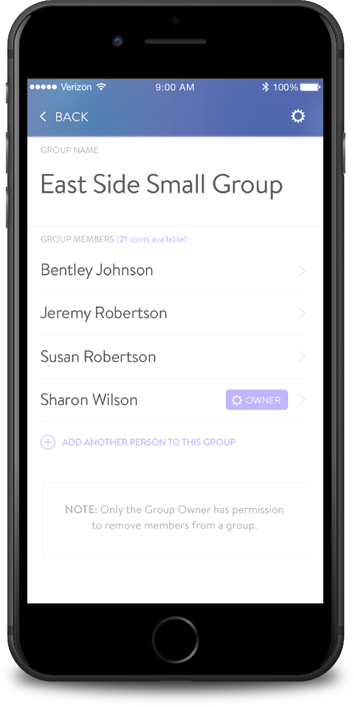
To create your group, tap GROUPS
then tap CREATE A NEW GROUP
NAME your group and then INVITE group members

Slide 4
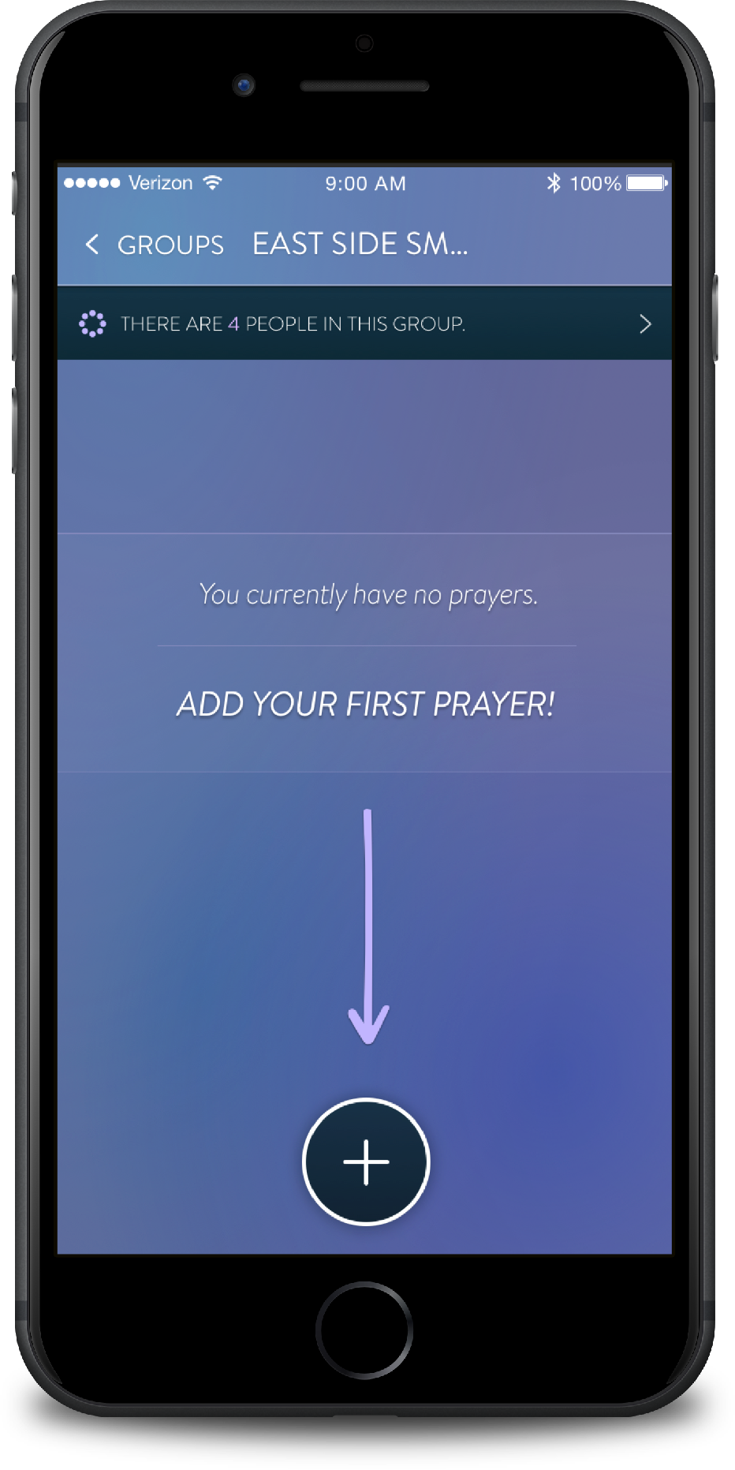
Once your group is created and people are invited, BEGIN ADDING PRAYERS!
REMEMBER:
Anyone in your group can add, edit and remove prayers.

Slide 5
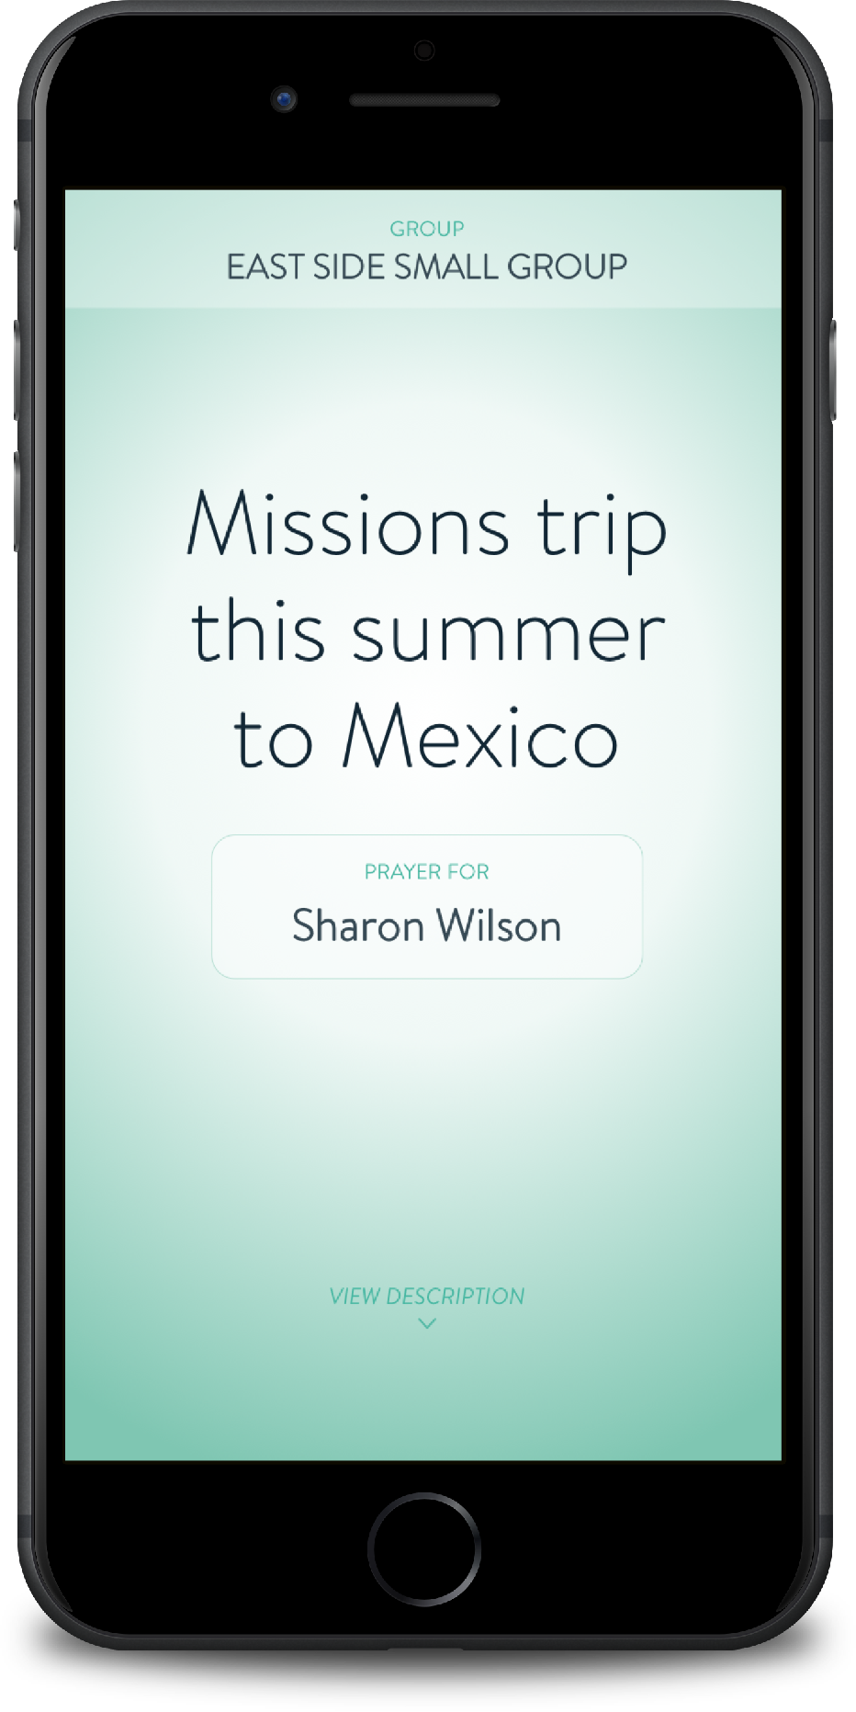
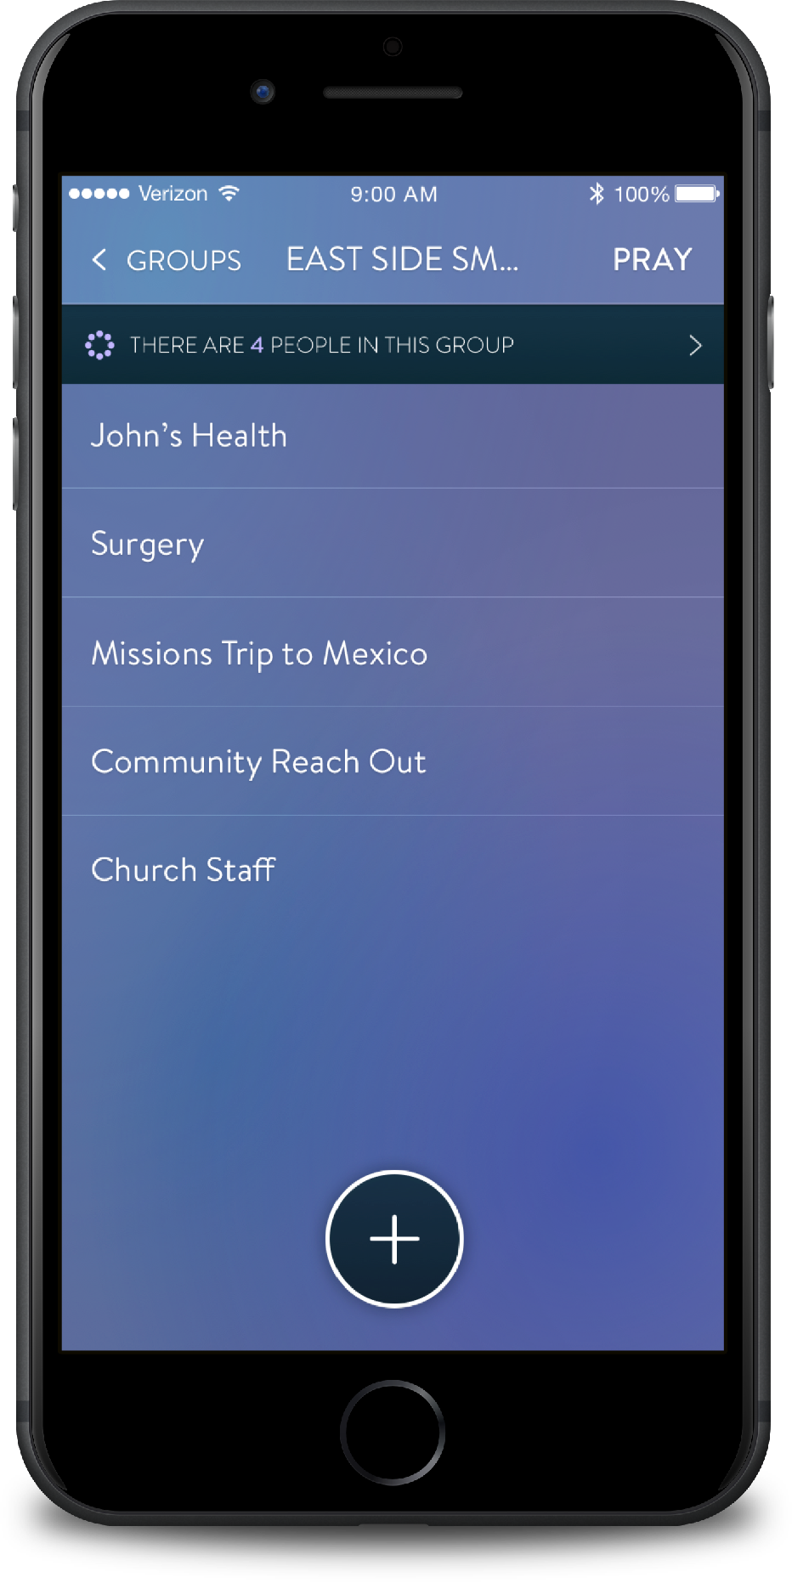
Now that your group has been created and prayers have been added…
PRAY!

Slide 6
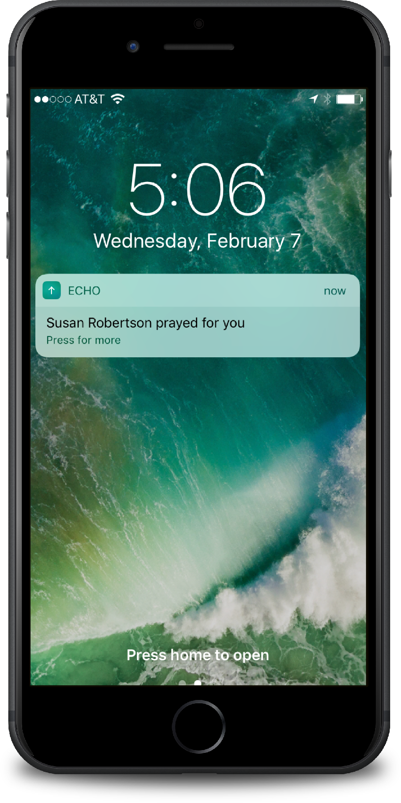
As you pray for each other, see
PRAYERS ANSWERED
& PEOPLE ENCOURAGED

Slide 7
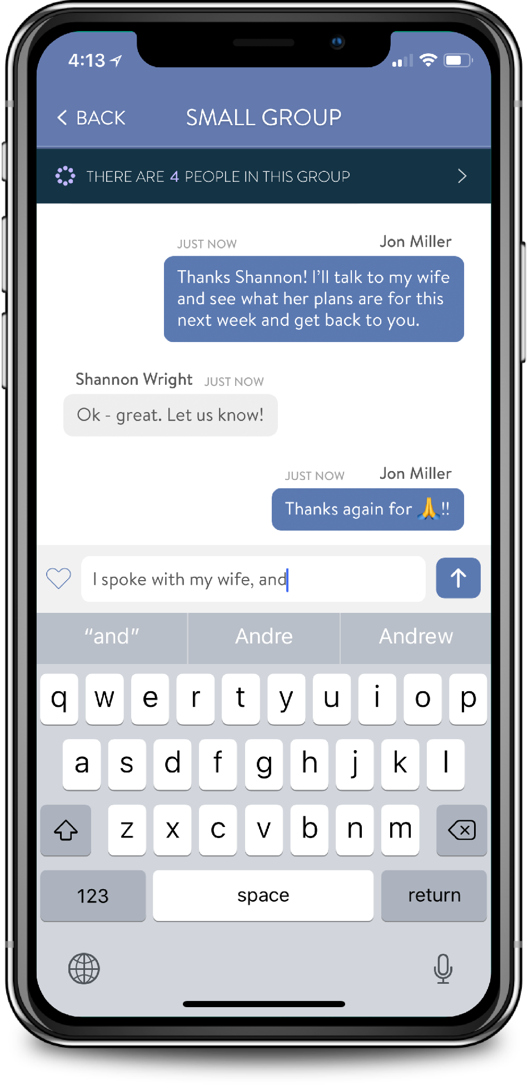
EASILY COMMUNICATE
with any of your groups through messaging!

Slide 8
Since every member is able to manage your list, groups are never centered around one individual.
Groups can change and grow
without the burden of administration falling on any one person.

Slide 9
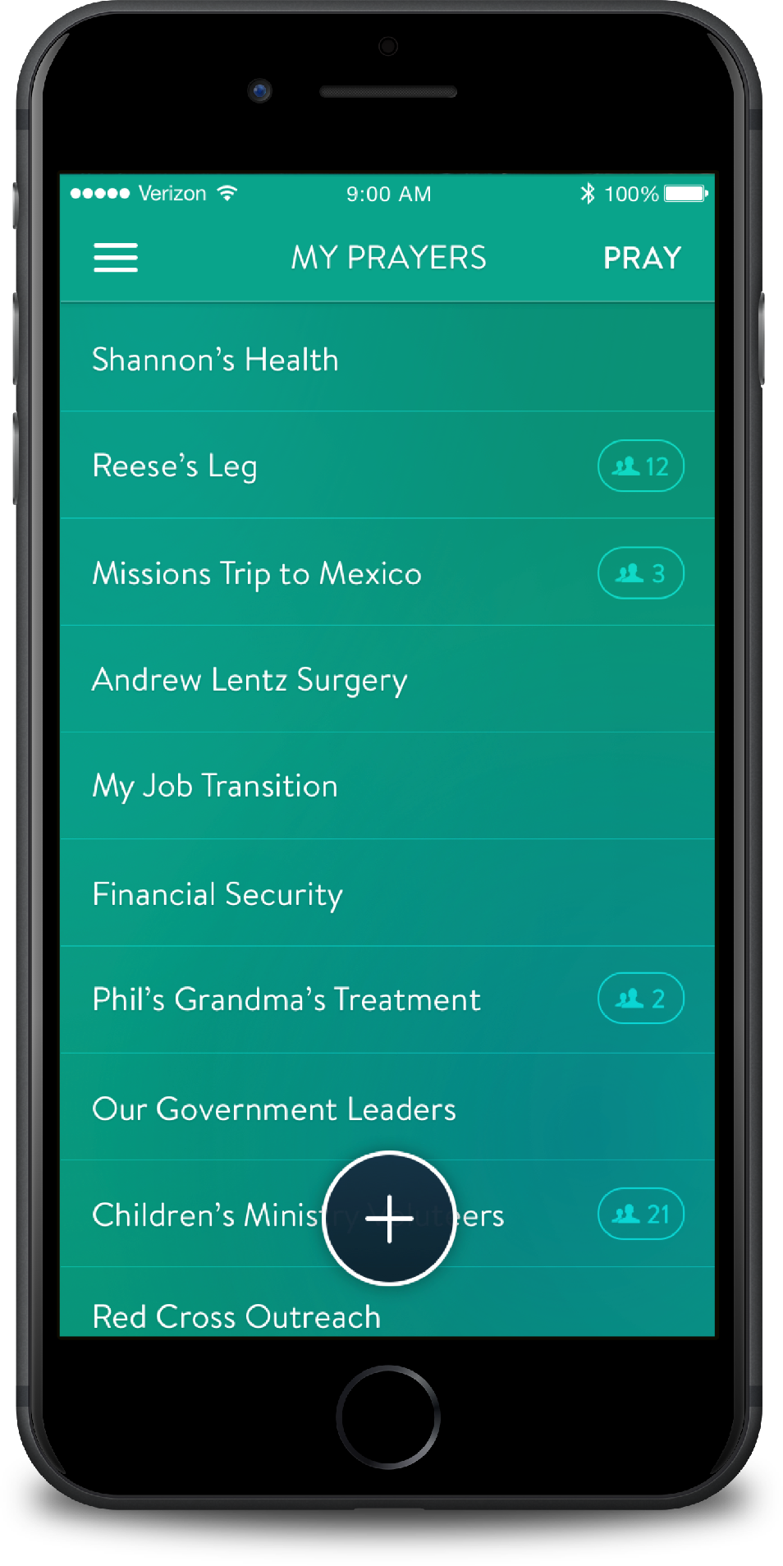
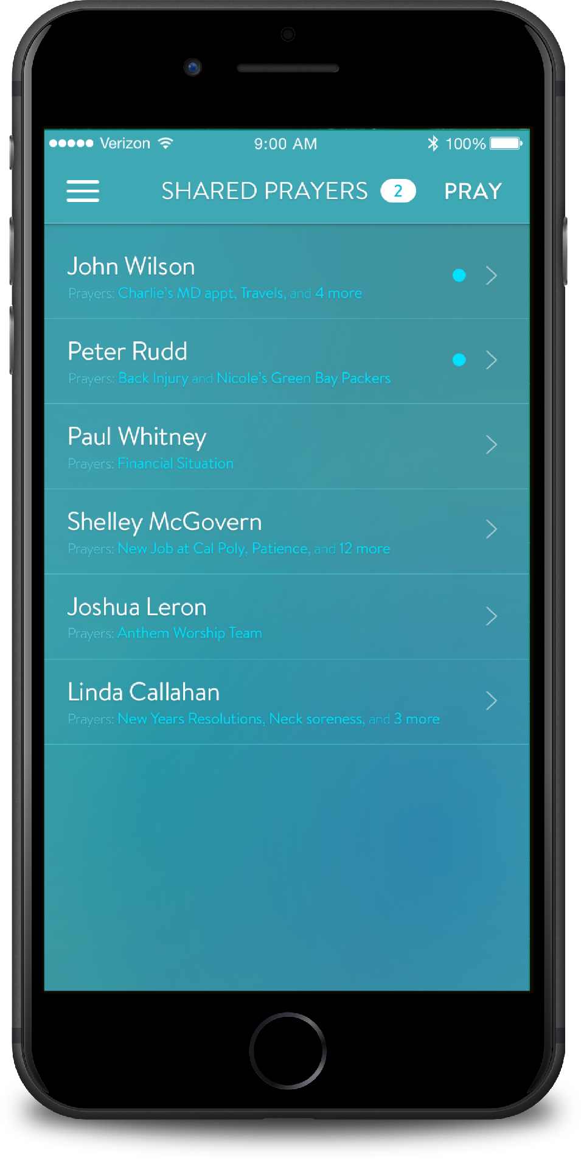
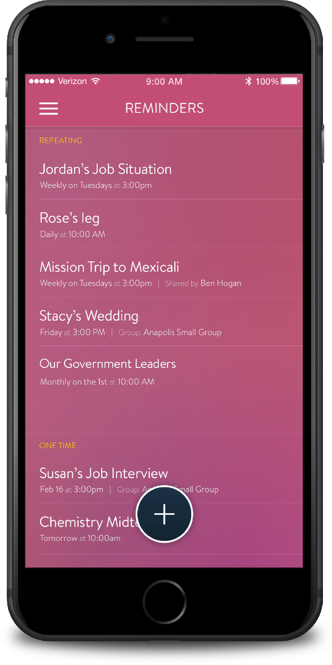
KEEP TRACK of your prayers
Along with using groups, the Echo Prayer App is full of features created to help make your prayer life as dynamic as possible.
Keep a list of prayers SHARED WITH YOU
SET REMINDERS
throughout the day to remind you to pray.

Slide 10
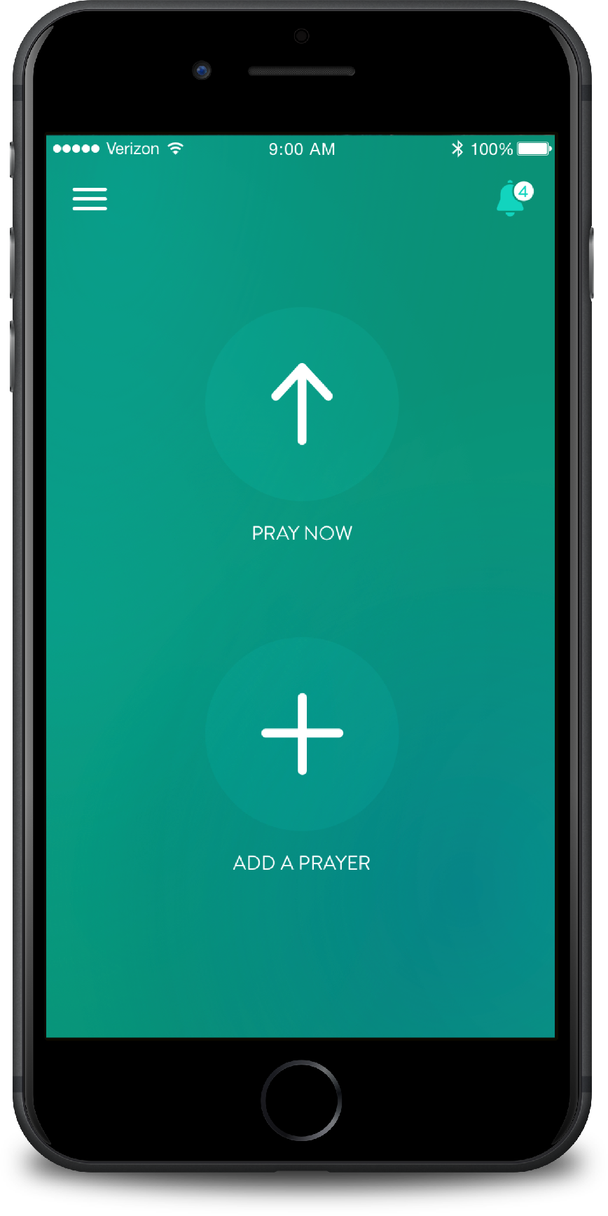
Download the Echo Prayer App for free in both the iTunes and Google Play stores today!
Learn more at echoprayer.com

